Slide 1
Foresight
Wendy McGuinness
McGuinness Institute

Slide 2
Notes:
UK Ministry of Defence publication
https://www.gov.uk/government/publications/global-strategic-trends-out-to-2055

Slide 3
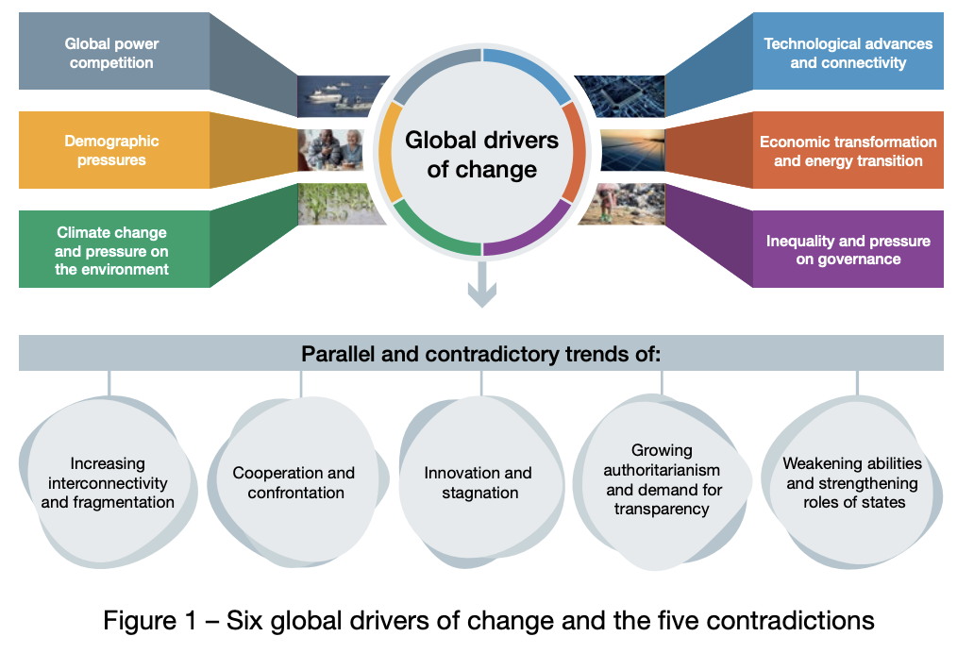
Taken together, the six global drivers of change will redefine societies, economies, governance, security and defence, as well the natural world itself. However, sitting alongside the six drivers are five core, interacting and dynamic contradictions, as illustrated in Figure 1.
Notes:
Defence Futures UK
https://assets.publishing.service.gov.uk/media/669923bda3c2a28abb50d236/GST_7_Bite_size_web.pdf

Slide 4
‘The ‘four future worlds’ is a scenario model used to facilitate discussions about the future of global order and geopolitics, as illustrated in Figure 4. Developed for GST 6, it uses two variables – distribution of power, and relations between actors – to define four future worlds.’
Notes:
Defence Futures UK
https://assets.publishing.service.gov.uk/media/669923bda3c2a28abb50d236/GST_7_Bite_size_web.pdf

Slide 5
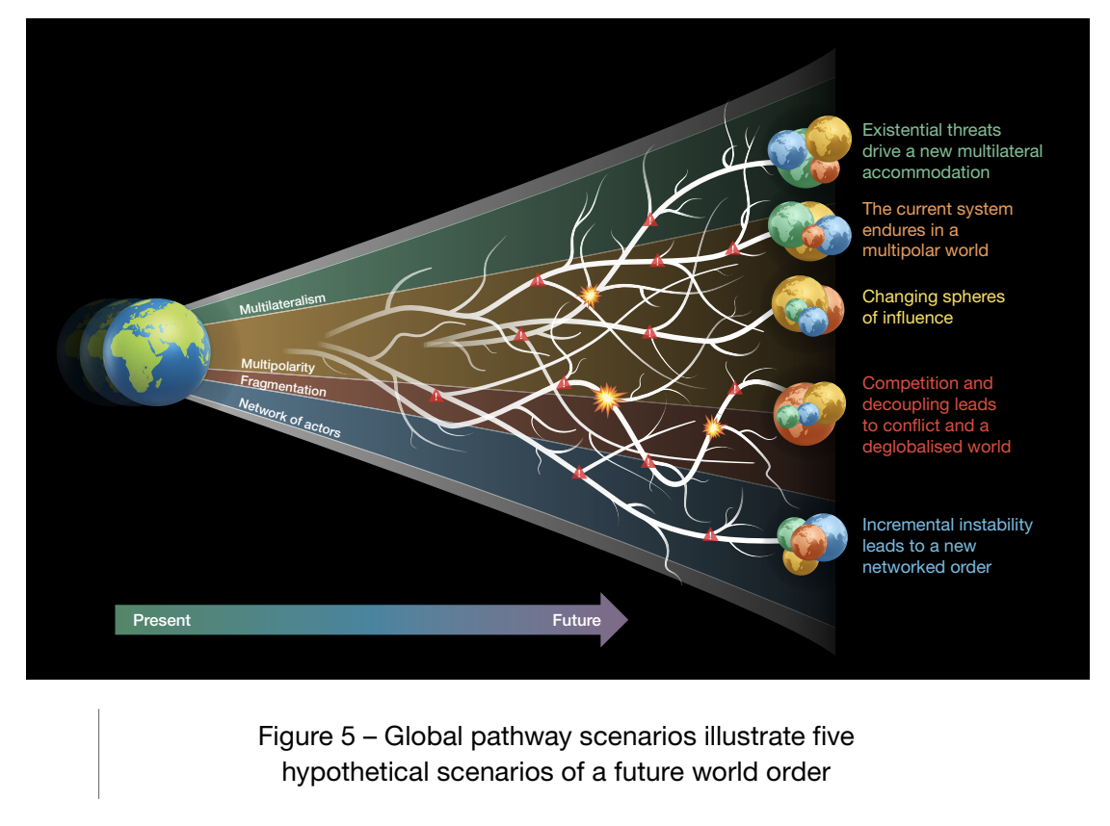
‘However, what is clear is that a future world will not appear in the purist way in which it is described in the model. Furthermore the path may result in the emergence of a very different world order than that anticipated, shaped by various shocks, developments and the responses of global actors.
To better reflect how various shocks and developments might influence global actors and drive future trajectories five hypothetical pathways have been developed. Each pathway results in the emergence of a different world order, shaped by changes in the balance of power and the international system and characterised by aspects of the ‘four future worlds’.
The five pathway scenarios are as follows, and illustrated in Figure 5.
Existential threats drive a new multilateral accommodation.
The current system endures in a multipolar world.
Changing spheres of influence.
Competition and decoupling leads to conflict and a deglobalised world.
Incremental instability leads to a new networked order.’
Notes:
Defence Futures UK
https://assets.publishing.service.gov.uk/media/669923bda3c2a28abb50d236/GST_7_Bite_size_web.pdf
.

Slide 7
Common language
Exploiting/work harder/building
Backcasting
Watchpoints
Red teaming (getting a separate independent group to challenge what they are doing – to identify)
War gaming/table top exercises – step breakout groups – think or do – to generate ideas
Stress test

Slide 9
There were five major flaws in the approach to risk assessment in the UK that had a material impact on preparedness for and resilience to whole-system civil emergencies such as pandemics:
Flaw 1: Too much reliance was placed on a single scenario – pandemic influenza – and on the likelihood of that scenario occurring. The effect was that risk was assessed too narrowly in a way that excluded other types of pandemic.
Flaw 2: Planning was focused on dealing with the impact of the disease (in this case, influenza) rather than preventing its spread. As a consequence, the levels of illness and fatalities of a pandemic were assumed to be inevitable and there was no consideration of the potential mitigation and suppression of the disease.
Flaw 3: Interconnected risks and a ‘domino effect’ were not adequately taken into account. There was a failure to appreciate how a whole-system civil emergency caused by a pandemic had the potential to spiral, as a result not only of the pandemic but also of the response to it.
Flaw 4: There was a failure to appreciate long-term risks and their effect on vulnerable people. This included a failure to appreciate the range of people who may be vulnerable to a pandemic (and, more generally, to whole-system civil emergencies) because of poor health and poverty, as well as those who may be vulnerable to the response to the pandemic.
Flaw 5: There was insufficient connection between the assessment of risk and the strategy and plan for dealing with it. This led to a failure to focus on the technology, skills, infrastructure and resources that would be needed to prevent or respond to a pandemic, such as testing, tracing and isolation.
Notes:
UK COVID-19 Inquiry (Module 1)
https://covid19.public-inquiry.uk/wp-content/uploads/2024/07/18095012/UK-Covid-19-Inquiry-Module-1-Full-Report.pdf

Slide 11
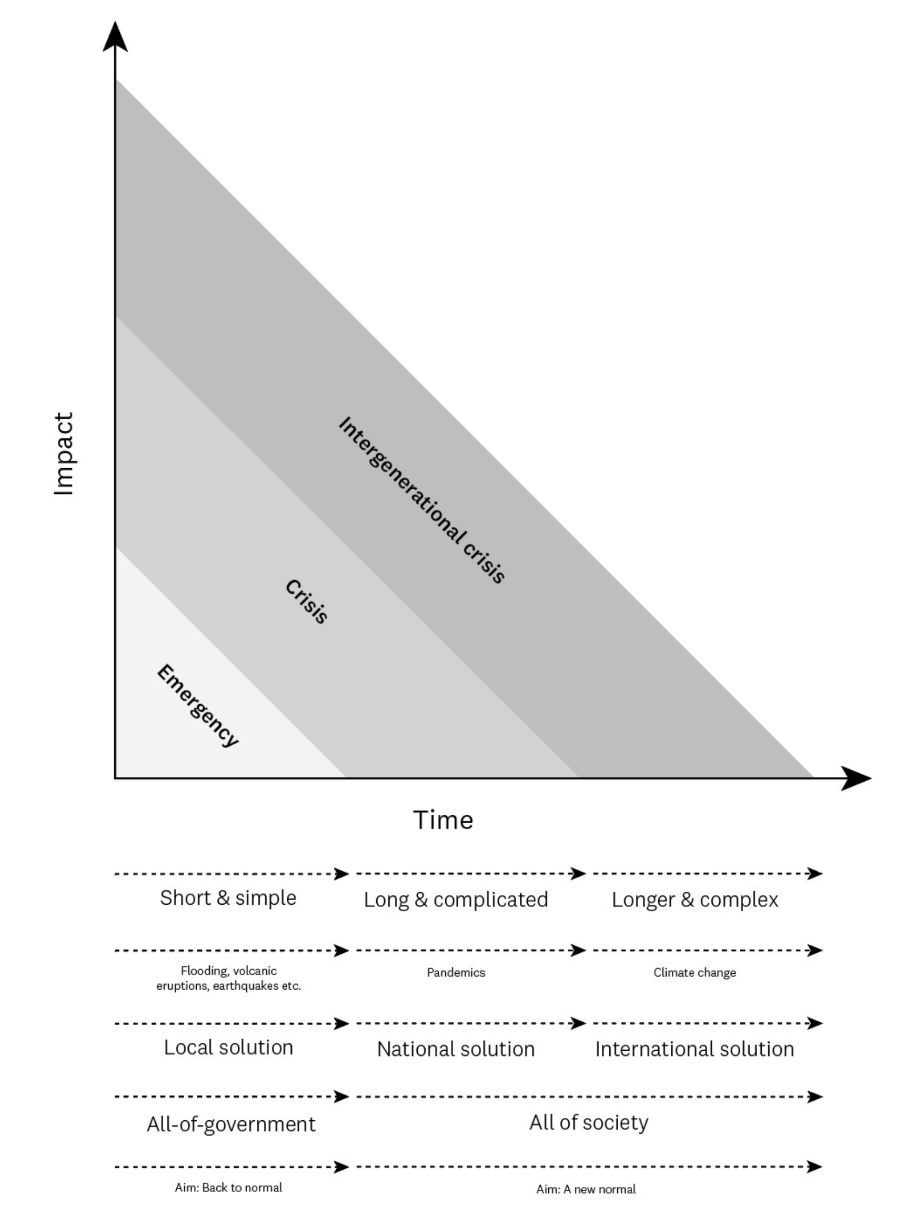
Upcoming: McGuinness Institute Discussion Paper 2024/03 Why we need to treat a crisis differently than an emergency

Slide 12
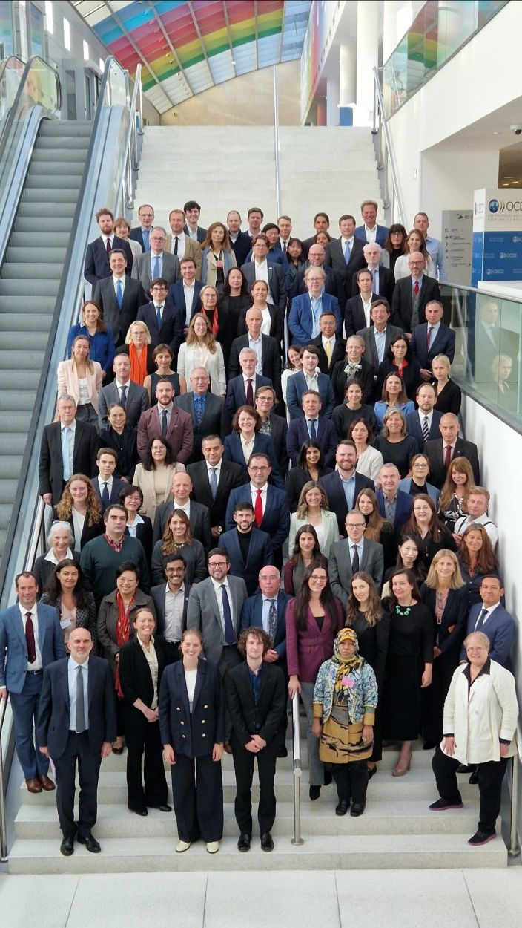
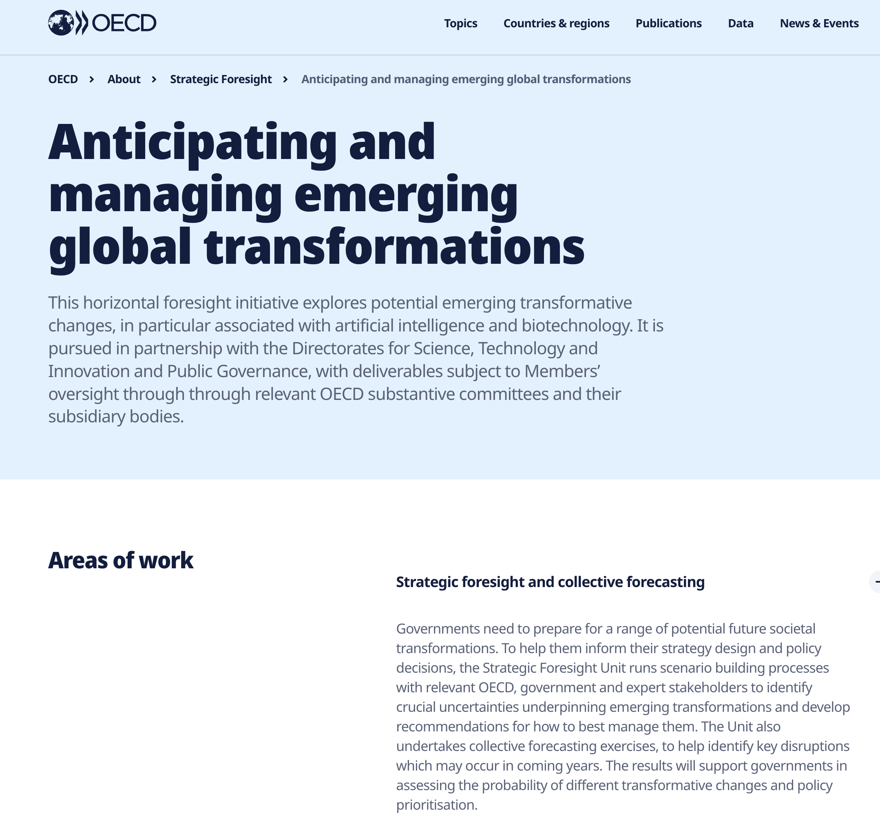
OECD
Notes:
OECD guidebook
https://oecd-opsi.org/wp-content/uploads/2024/09/OPSI_Capability-Building-Programmes-Strategic-Foresight-FINAL.pdf

Slide 13
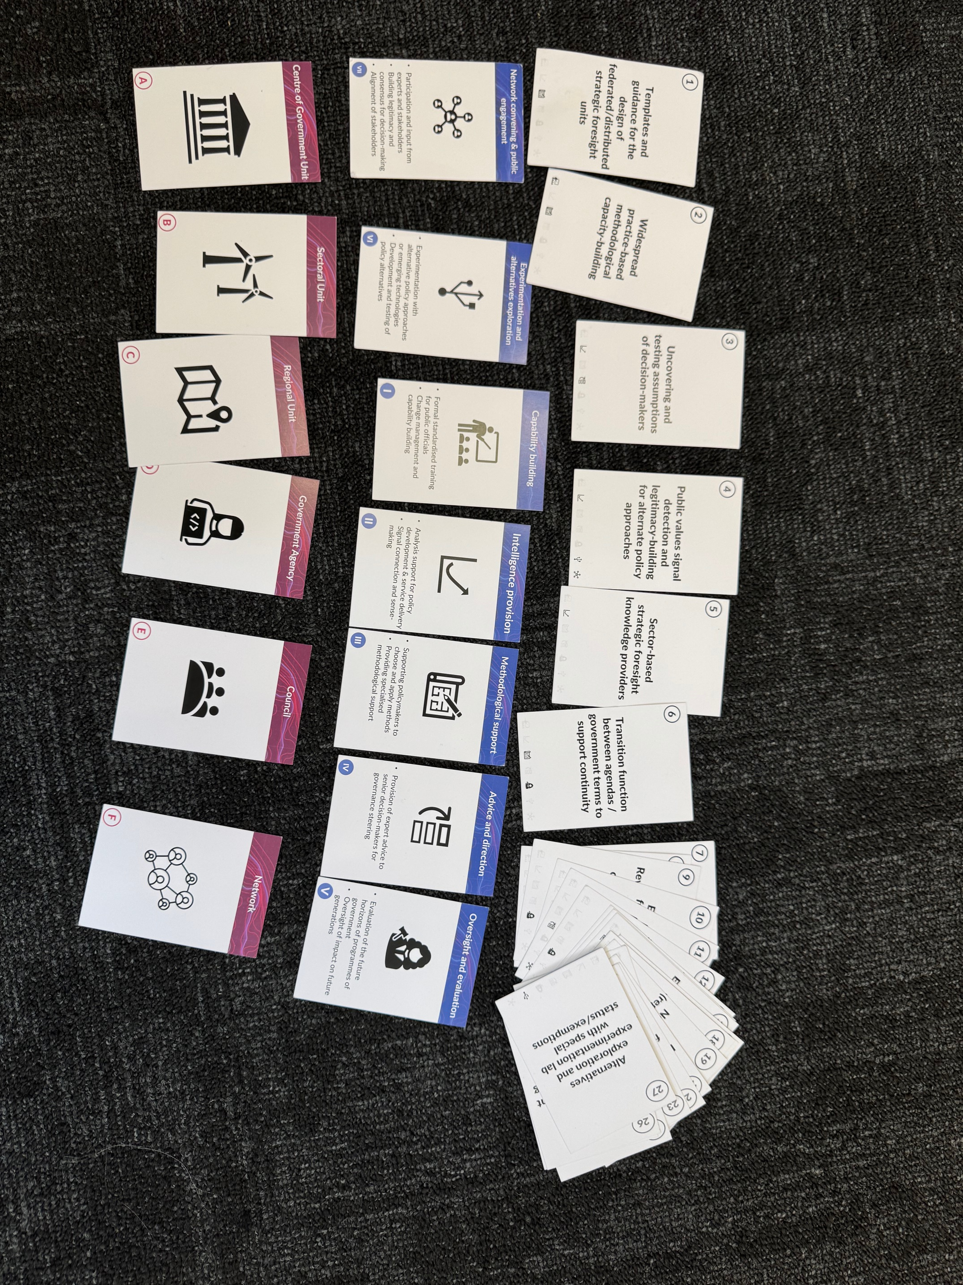

Slide 14
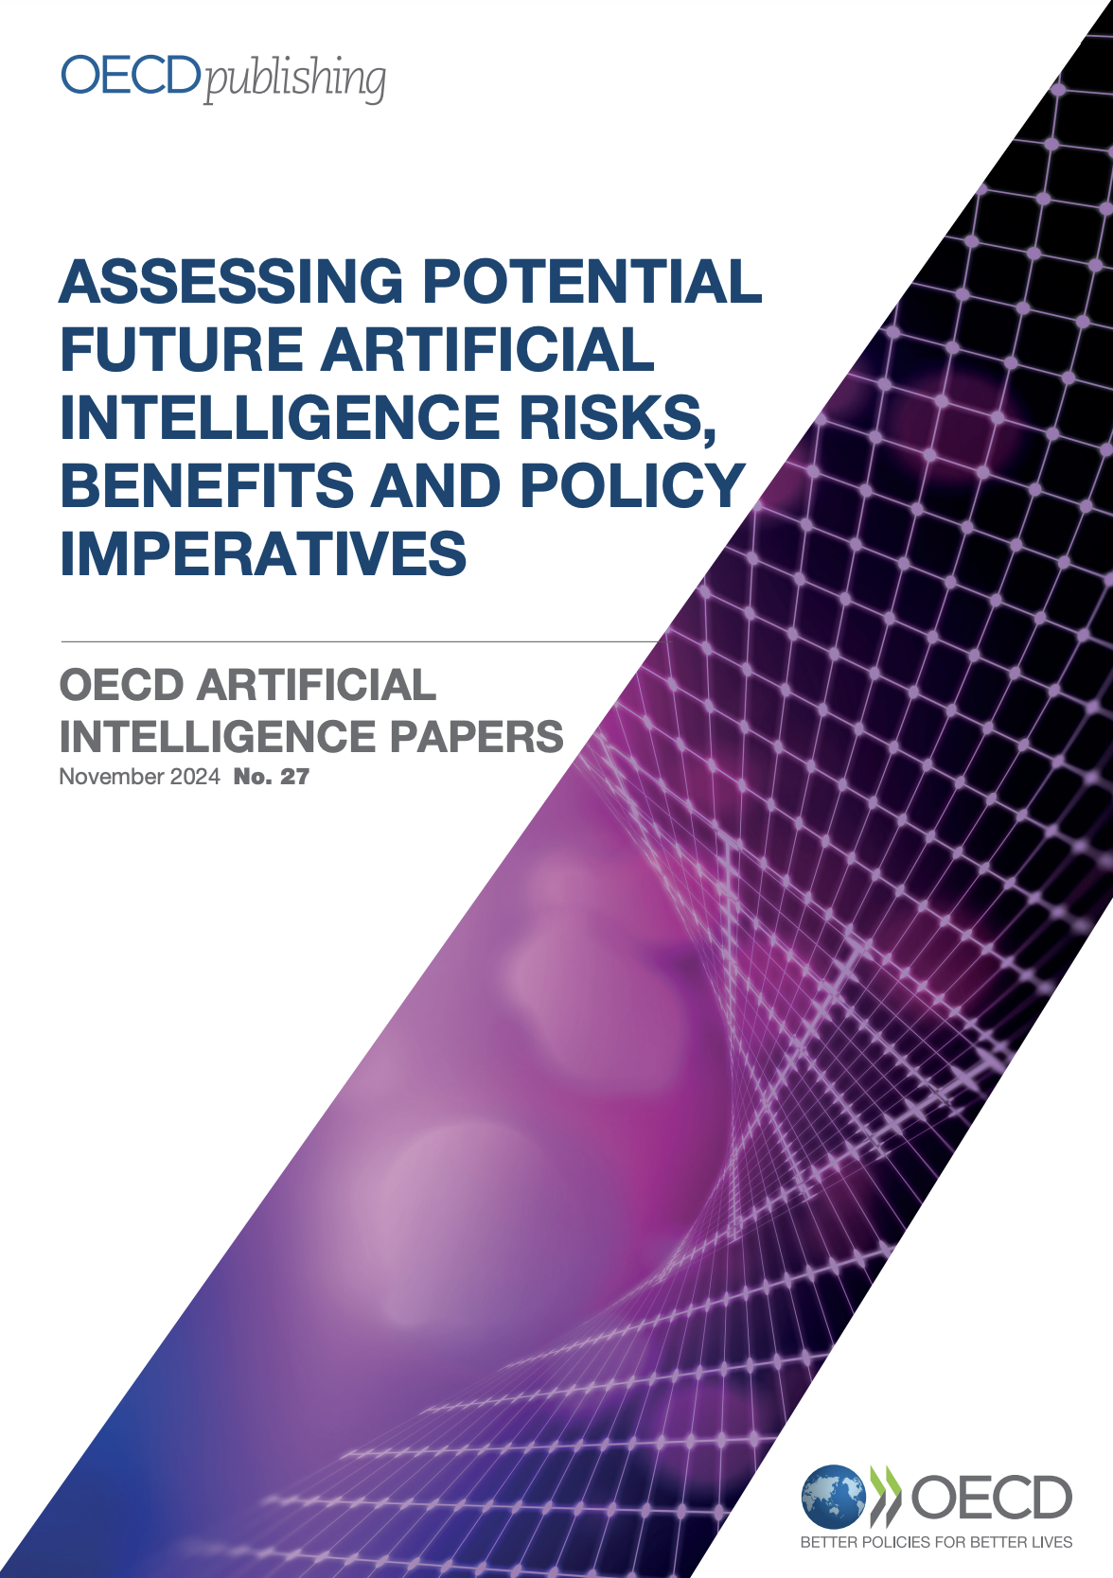
The swift evolution of AI technologies calls for policymakers to consider and proactively manage AI-driven change. The OECD’s Expert Group on AI Futures was established to help meet this need and anticipate AI developments and their potential impacts.
Informed by insights from the Expert Group, this report distils research and expert insights on prospective AI benefits, risks and policy imperatives. It identifies ten priority benefits, such as accelerated scientific progress, productivity gains and better sense-making and forecasting. It discusses ten priority risks, such as facilitation of increasingly sophisticated cyberattacks; manipulation, disinformation, fraud and resulting harms to democracy; concentration of power; incidents in critical systems and exacerbated inequality and poverty.
Finally, it points to ten policy priorities, including establishing clearer liability rules, drawing AI “red lines”, investing in AI safety and ensuring adequate risk management procedures. The report reviews existing public policy and governance efforts and remaining gaps.
Notes:
OECD report
https://www.oecd.org/en/publications/assessing-potential-future-artificial-intelligence-risks-benefits-and-policy-imperatives_3f4e3dfb-en.html

Slide 15
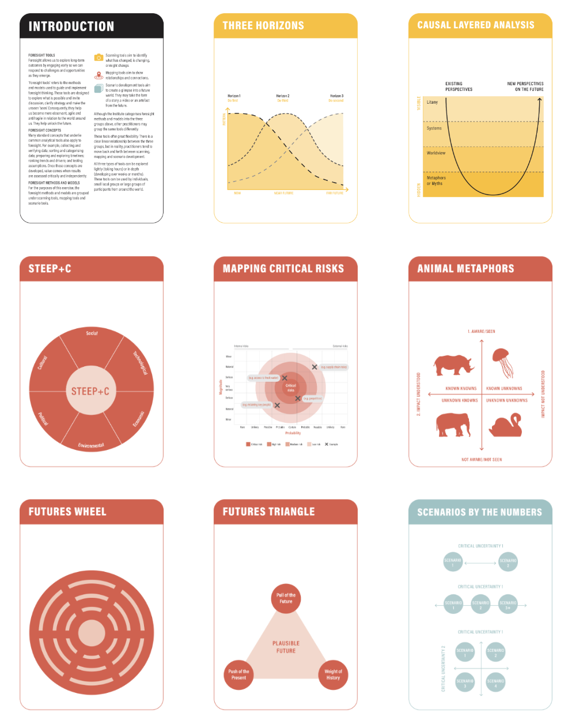
Foresight Tools cards
Foresight 1
Foresight 2
Notes:
McGuinness Institute Foresight Tools cards
https://www.mcguinnessinstitute.org/foresight-tools/

Slide 16
Prime Ministers summer reading list
Notes:
Prime Ministers summer reading list – blog to come
https://www.mcguinnessinstitute.org/publications/blog/

Slide 17
Thank you

